Slide 1


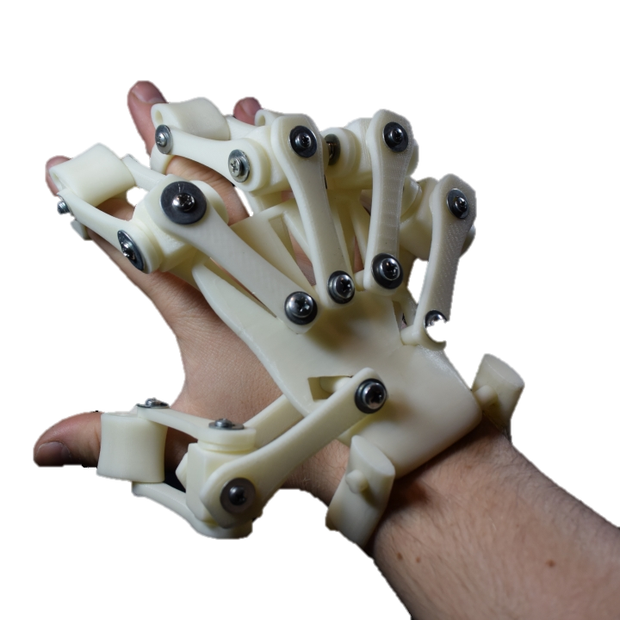
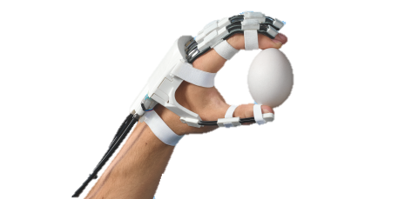
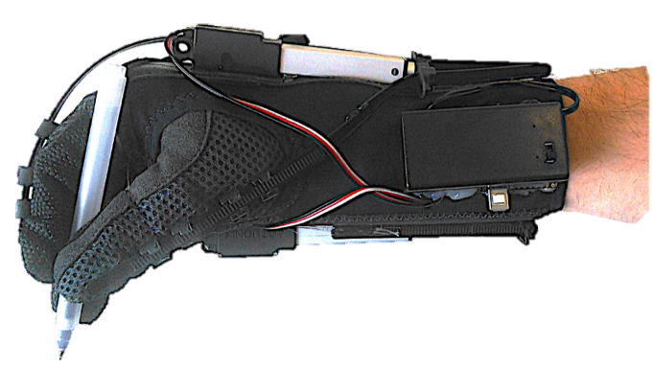
Designing an assistive hand exoskeleton for a patient with limited hand mobility
Petros Kaltsas
Giuseppina Ciniglio

Slide 2
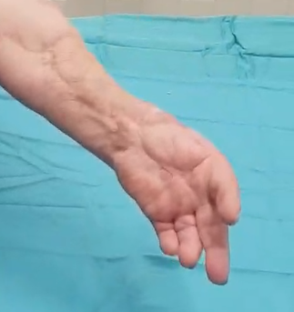
Get to know the patient
Our goal
Male, around 60s
No Thumb nor tendons on the fingers
Broken tendons in the palm
Fingers close passively
Wrist barely working
Design an assistive device (exoskeleton) that could help the patient to perform some basic Activities of Daily Living (ADL)

Slide 3
The device should be:
It would be good if the device could:
Helping the patient to perform some basic grasps (thumb opposition)
Portable (Low weight, wire connections)
Self powered (Taking advantage of the elbow movement)
Comfortable
S I M P L E
S A F E
Be low-cost
Fit under the clothes
Be worn easily (Using only one hand)
Be robust (As minimum maintenance as possible)
Be aesthetically nice

Slide 4
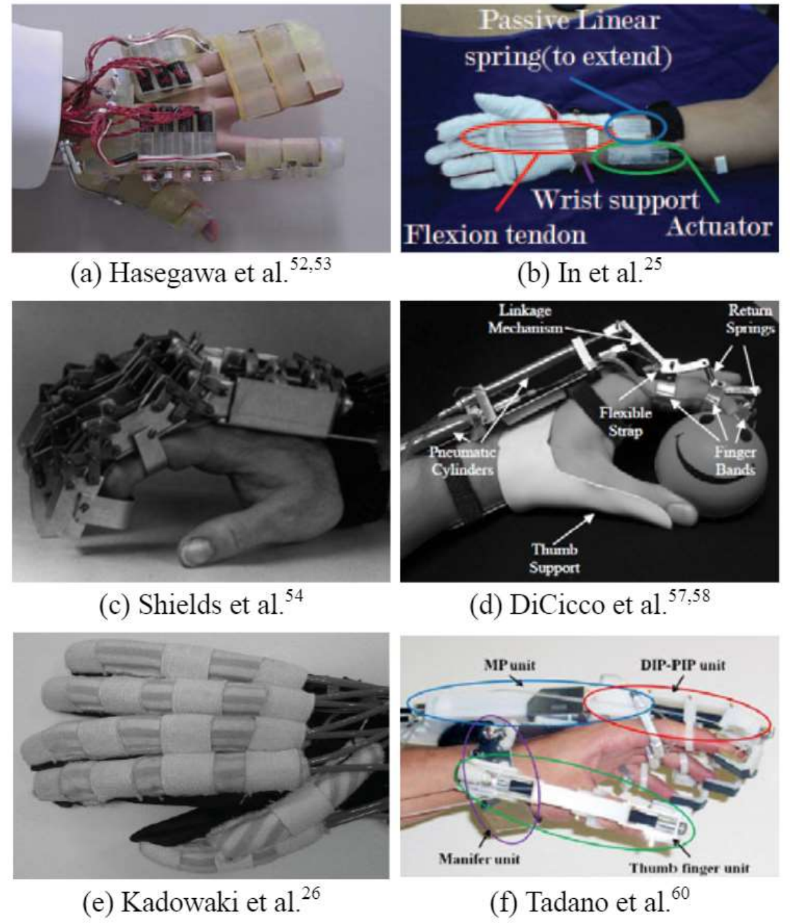
Review of Literature
Many Hand exoskeletons have been developed recently, but most of them have the following characteristics:
Developed for rehabilitation purposes, or haptic interfaces,
Designed to assist persons with massive disabilities, like quadriplegic,
Bulky.
There is only a very small number of portable, self powered, assistive hand exoskeletons.
Heo, Pilwon, et al. "Current hand exoskeleton technologies for rehabilitation and assistive engineering." International Journal of Precision Engineering and Manufacturing 13.5 (2012): 807-824.

Slide 5
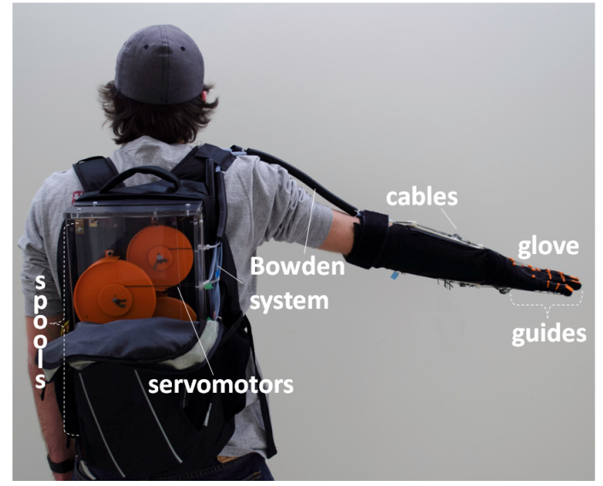
Rehabilitation vs Assistance
While there is a very big amount of information available, regarding hand exoskeletons used in rehabilitation, there is a key difference, that needs to be considered:
Rehabilitation devices operate in medical labs and clinics.
Bulk and weight is not an issue.
Heavy instruments such as compressors and power supplies can be implemented.
Are used by many patients so high cost can be justified
Delph, Michael A., et al. "A soft robotic exomusculature glove with integrated sEMG sensing for hand rehabilitation." 2013 IEEE 13th International Conference on Rehabilitation Robotics (ICORR). IEEE, 2013.

Slide 6
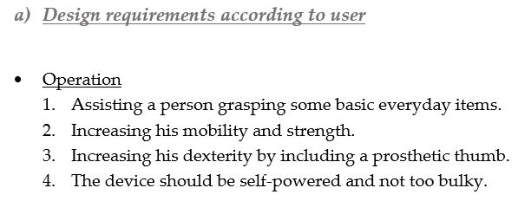
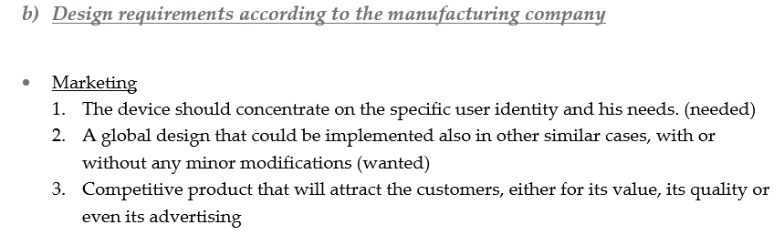
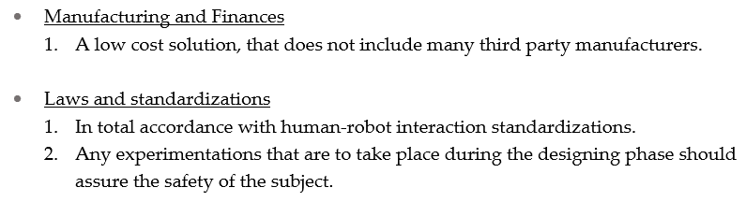
Our method
We define some design requirements and we break the main function of the device in smaller tasks
Similarly, we define some design requirements for:
Operating environment
Cost
Safety
Dimensions
Robustness
Stiffness
Appearance
Ease of use
Service & Maintenance
Credibility

Slide 7
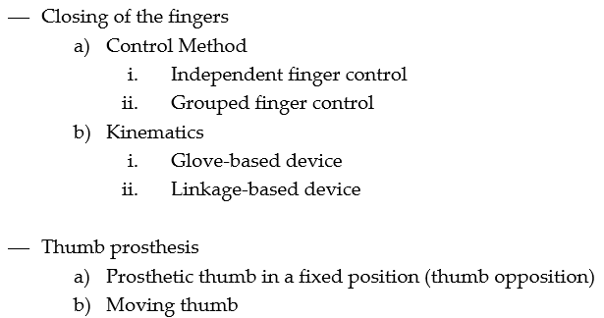
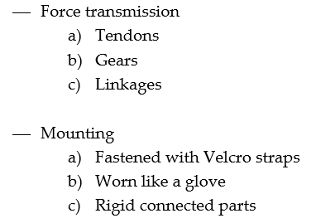
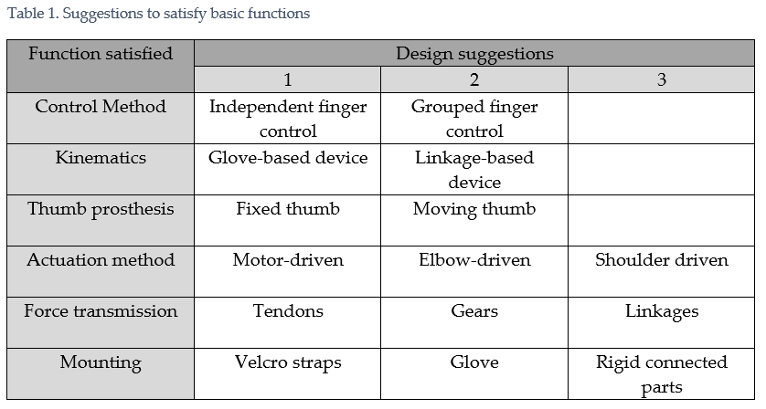
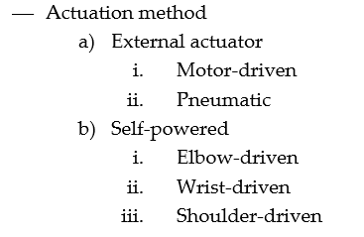
Example
Brainstorming, to find as many solutions as possible for each task and we make all the combinations.

Slide 8
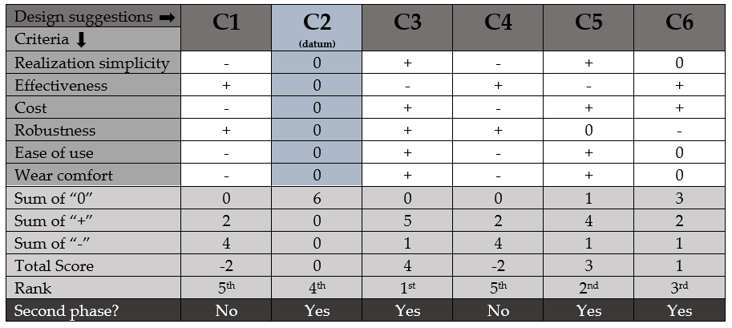
Example
After we define some criteria, we pick some of the combinations and we proceed to filtering and screening in 2 stages.

Slide 9
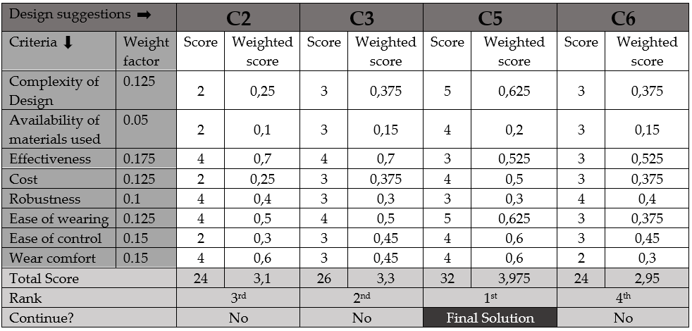
Example

Slide 10
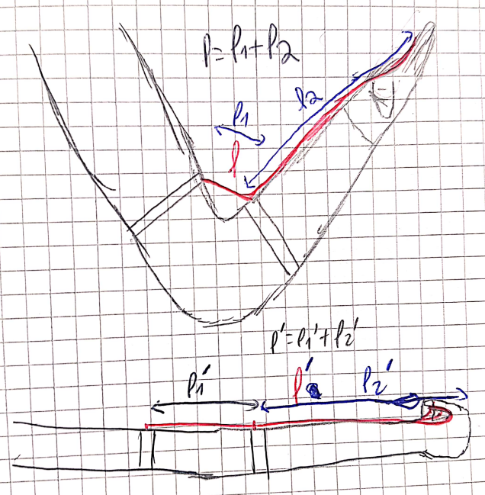
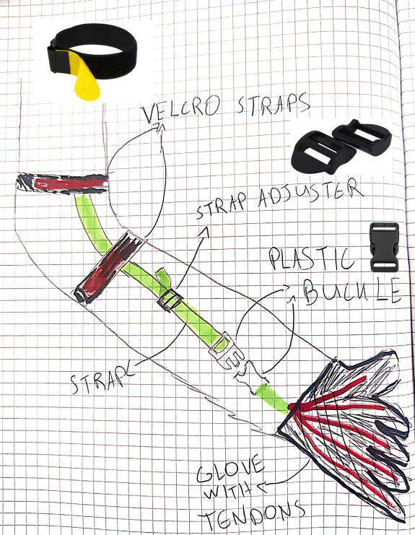
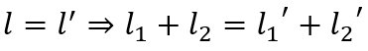
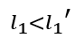
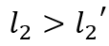
Quick sum up
Main Function
User is flexing/extending his elbow and his hand is closing
Parts of the device and their functions
On the hand: Fastening | Closing of the fingers
Actuation mechanism: Transferring elbow motion to the fingers
Arm: Fastening | Housing the actuation mechanism
Thumb: Thumb opposition | Stability
Working Principle
Fingers are pulled

Slide 11
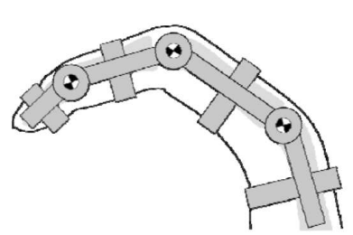
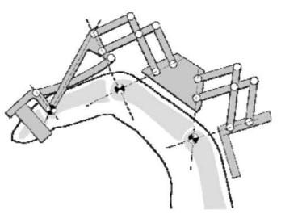
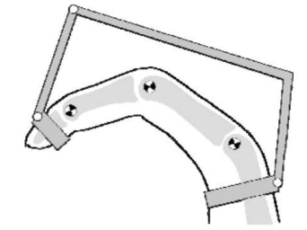
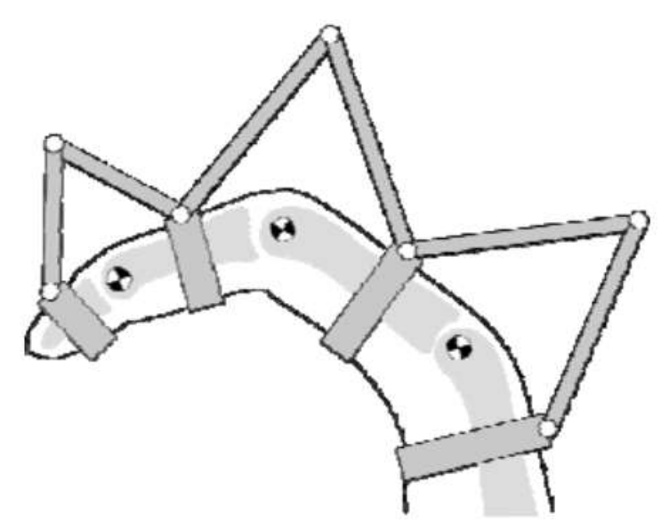
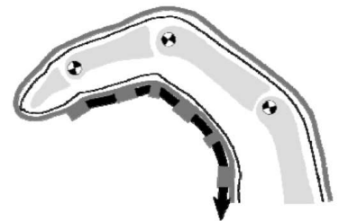
Limitations & Challenges
Center of rotation:
The centers of rotation of the exoskeleton structure needs to coincide with the one of the fingers.
Solutions:
Direct Matching
Remote COR
Linkage attached to the distal segment
Redundant linkage
Compliant structure
Not enough space between fingers
Bulky & Complex
Heo, Pilwon, et al. "Current hand exoskeleton technologies for rehabilitation and assistive engineering." International Journal of Precision Engineering and Manufacturing 13.5 (2012): 807-824.

Slide 12
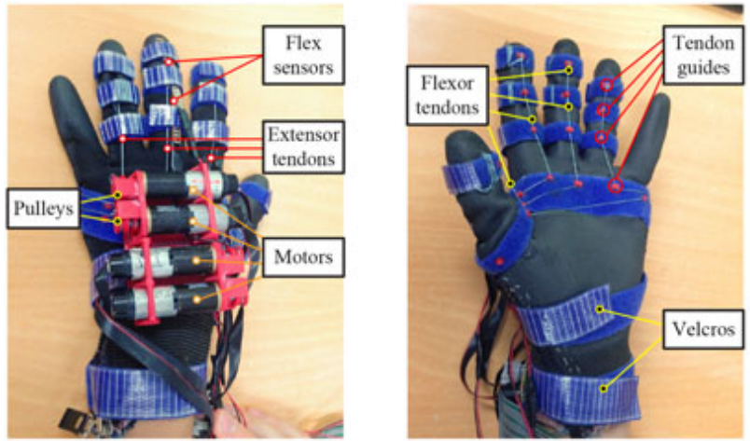
Limitations & Challenges
Weight:
The use of motors as actuators, requires the implementation of controllers and power supply.
Cons: Weight and Space
Solutions:
Sometimes, the additional equipment is kept aside, mounted on the body of the user or put in his pocket. However, wiring connections still affect the device’s discreteness.
Popov, Dmitry, Igor Gaponov, and Jee-Hwan Ryu. "Portable exoskeleton glove with soft structure for hand assistance in activities of daily living." IEEE/ASME Transactions on Mechatronics 22.2 (2016): 865-875.

Slide 13
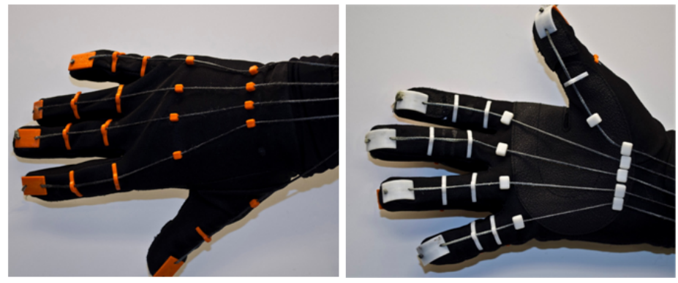
Limitations & Challenges
Comfort:
When tendons are used to close the fingers, depending on their routing there are two problems:
If they are on the dorsal side of the hand, while pulled, they pull the wrist backwards.
Solution: Maybe a wrist strengthener could help.
If they are on the palmar side of the hand, they cover the palm affecting grasping efficiency.
Solution: The use of a glove solves the problem.
Delph, Michael A., et al. "A soft robotic exomusculature glove with integrated sEMG sensing for hand rehabilitation." 2013 IEEE 13th International Conference on Rehabilitation Robotics (ICORR). IEEE, 2013.

Slide 14
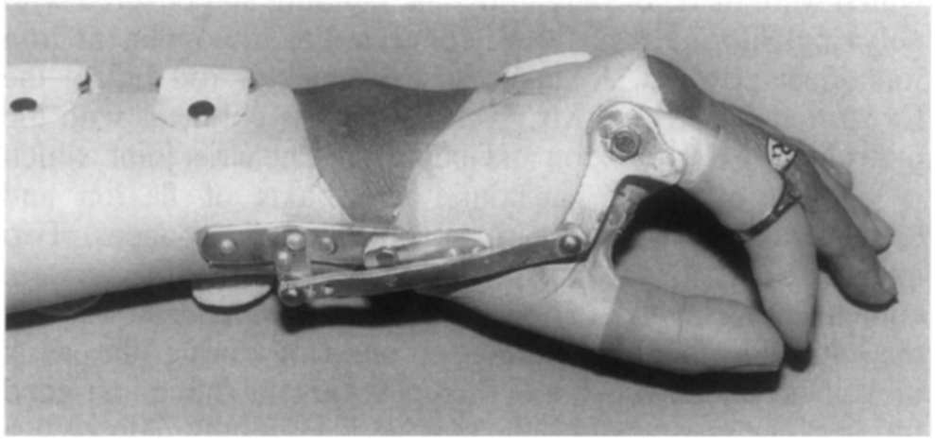
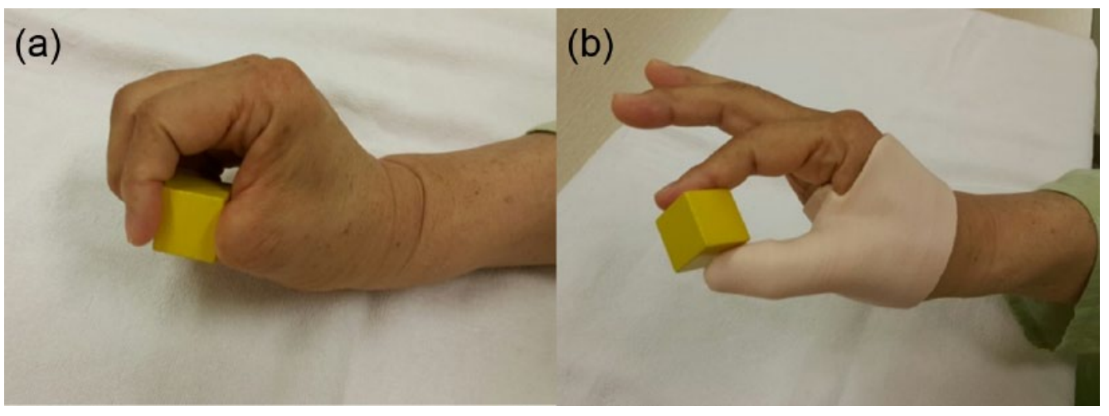
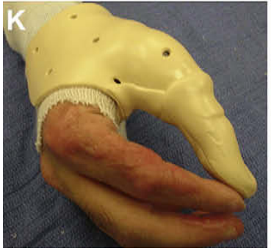
Limitations & Challenges
Thumb:
Fixed thumb: The optimal position should be studied, for various grasps.
Moving thumb: Stability and robustness might be an issue.
Shim, Jae-Ho, et al. "Wrist-driven prehension prosthesis for amputee patients with disarticulation of the thumb and index finger." Archives of physical medicine and rehabilitation 79.7 (1998): 877-878.
Lee, Keun Ho, et al. "Three-dimensional printed prosthesis demonstrates functional improvement in a patient with an amputated thumb: a technical note." Prosthetics and orthotics international 42.1 (2018): 107-111.
Dewey, W. S., et al. "Opposition splint for partial thumb amputation: a case study measuring disability before and after splint use." Journal of Hand Therapy 22.1 (2009):.

Slide 15
Conclusion
Design of an assistive hand exoskeleton:
Portable
Self powered
Efficient
Simple
Safe

Slide 16


Now
We would like to here your suggestions and ideas regarding:
Fastening on the hand
Closing the fingers
Elbow mechanism
Fastening on the arm
Thumb design
Thank you!

